Slide 1
Programmatic solutions to the 1D Infinite Potential Well
The “Shooting and Matching” Method

Slide 2
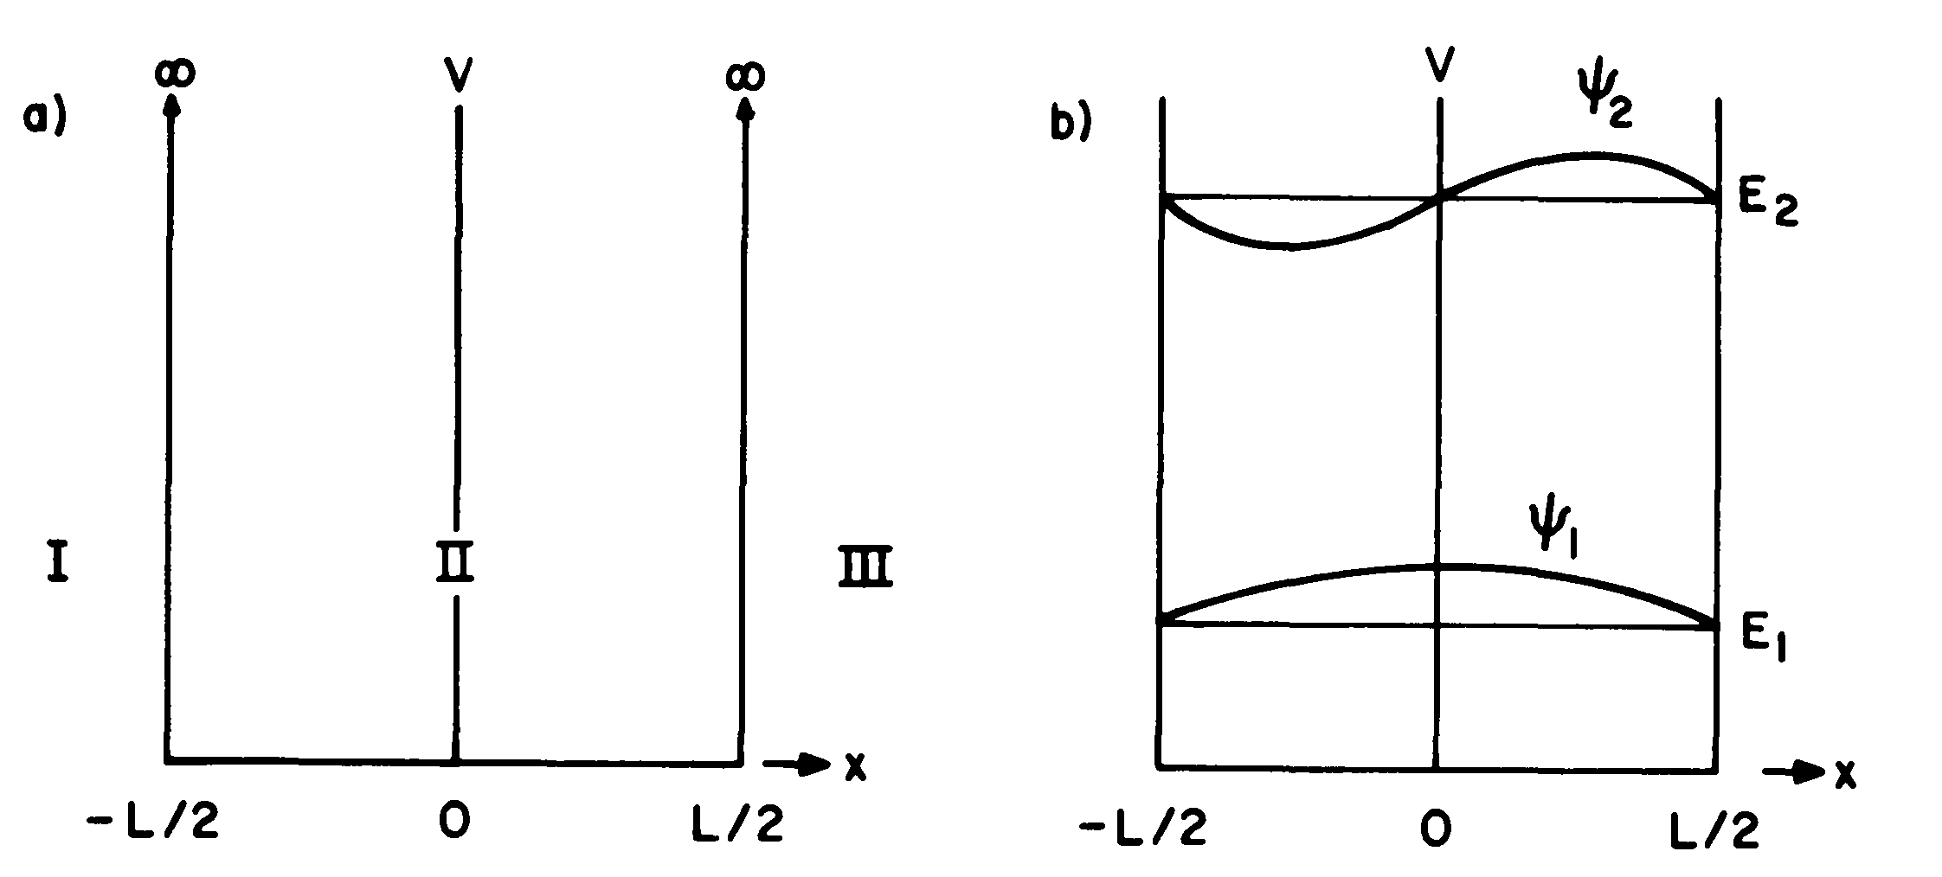
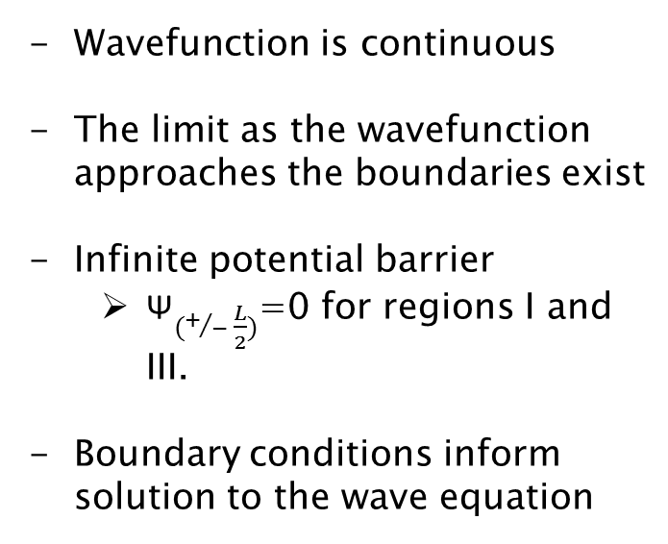
Background
Wavefunction is continuous
The limit as the wavefunction approaches the boundaries exist
Infinite potential barrier
${\text{Ψ}}_{(+/− \frac{L}{2})}$=0 for regions I and III.
Boundary conditions inform solution to the wave equation

Slide 3
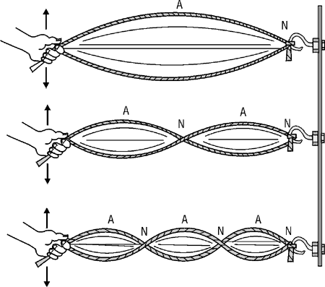

Solution
$\text{Ψ} \left(x\right)=\left\{\begin{aligned}\sin{\frac{nπ}{L}x}, n is even \\ &\cos{\frac{(2n−1)π}{L}x}, n is odd\end{aligned}\right.$
Only standing waves can be solutions
Each standing wave has a particular energy
These quantized energies are the solutions to the wave equation

Slide 4
Why model it computationally?
- Infinite potential square well is basic, easy to solve analytically
- Things, of course, get more complicated…

Slide 5
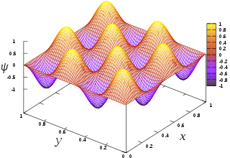
Complex Potential Wells

Slide 6
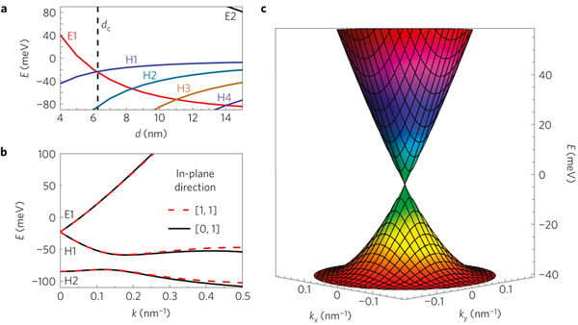
More complex Potential wells

Slide 7
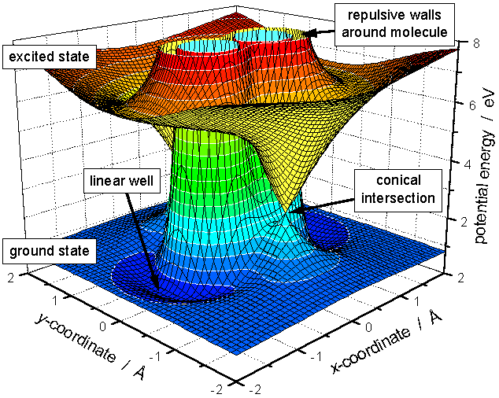
Much More complex potential wells

Slide 8
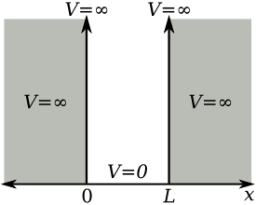
Start simple

Slide 9
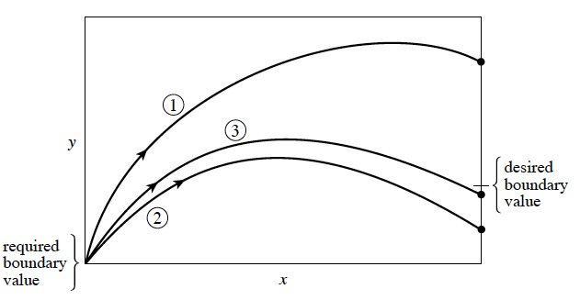
Method of Solving
“Shooting and Matching”
-Take a shot
Too low, adjust higher
Too high, adjust lower
-Rinse and repeat

Slide 10
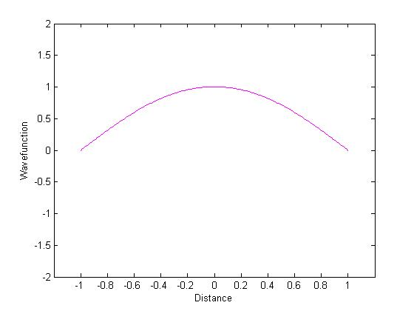
Simulation
- Select initial energy level
- adjust dE depending on how solution’s boundary value compares to boundary conditions
-Runs simulation until dE is at desired level
-Let’s “ground” our knowledge with some practice, and find solutions to the wave equation!

Slide 11
Results
Energy Level | “Guess” Energy | Stable State Solution
N = 0 | 10 | 1.2715
N = 2 | 20 | 11.4419
N = 4 | 40 | 31.7722
N = 6 | 80 | 62.2418
N = 8 | 120 | 102.8198

Slide 12
Conclusions – future directions
Modeling more complex potential wells
Tunneling

